Slide 1
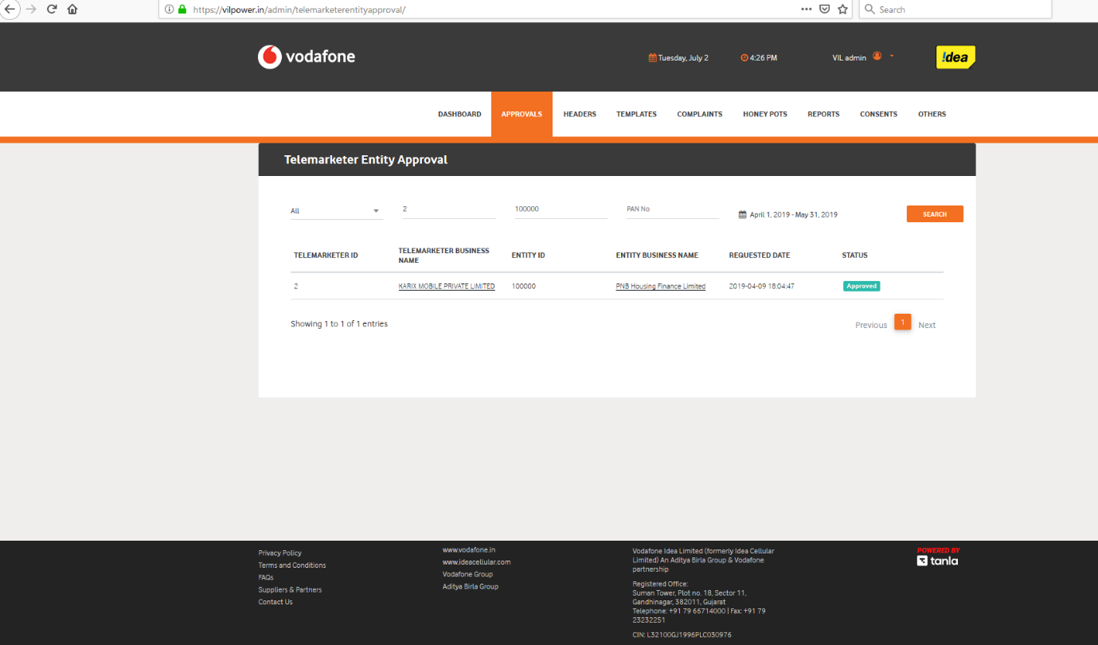
Above screen shows PNB Housing(PE) approved for Karix Mobile private limited (TM) by operator.

Slide 2
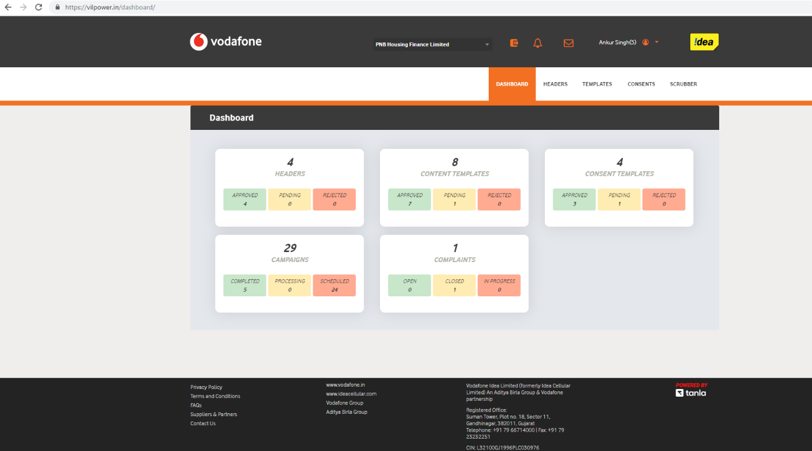
PE-PNB Housing dashboard showing list of headers/templates, consents etc registered.

Slide 3
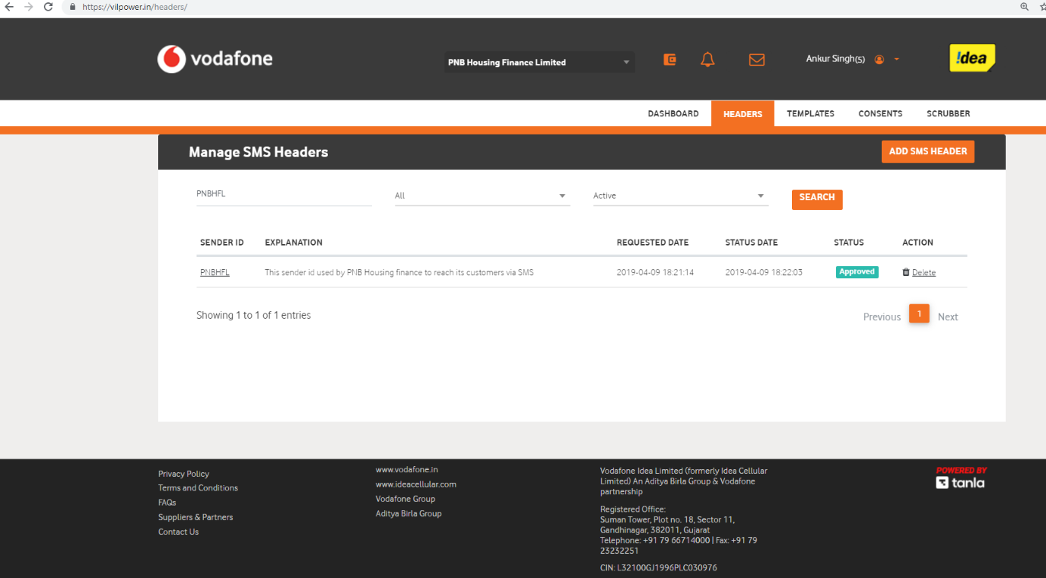
PNBHFL header registration for PE-PNB Housing Finance limited.

Slide 4
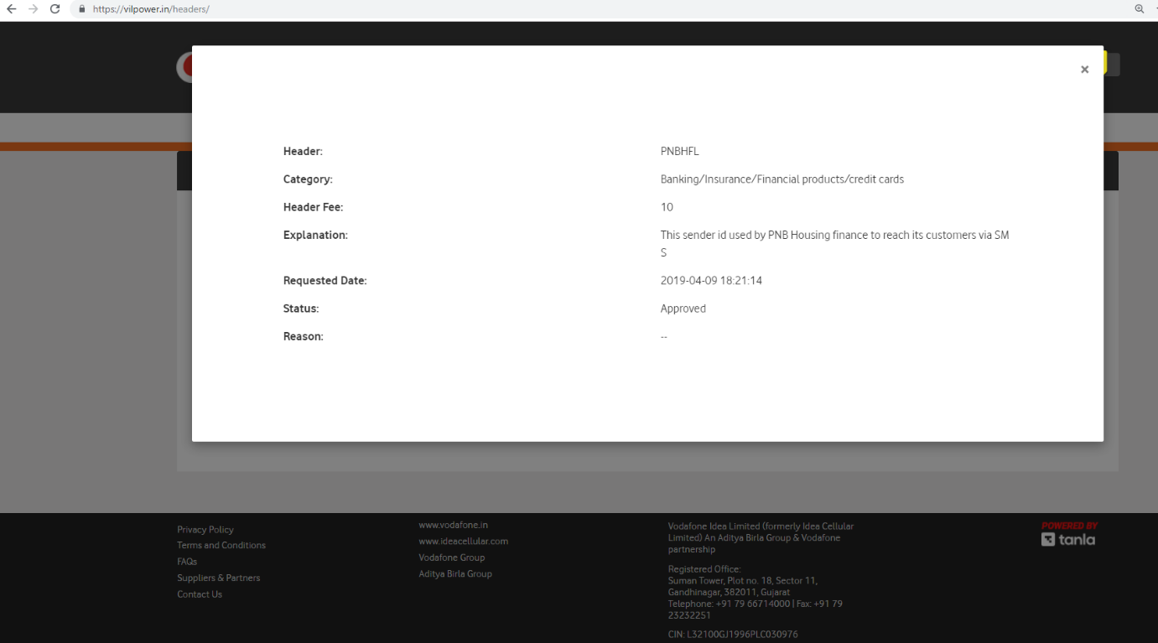
Detailed view of header-PNBHFL:

Slide 5
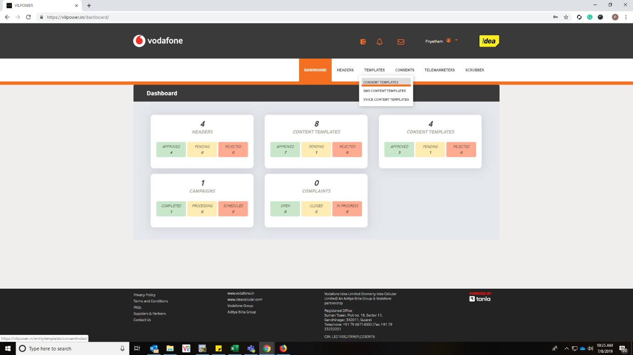
Login to Principle Entity , Go to TEMPLATES Tab and in dropdown, click Consent Templates

Slide 6
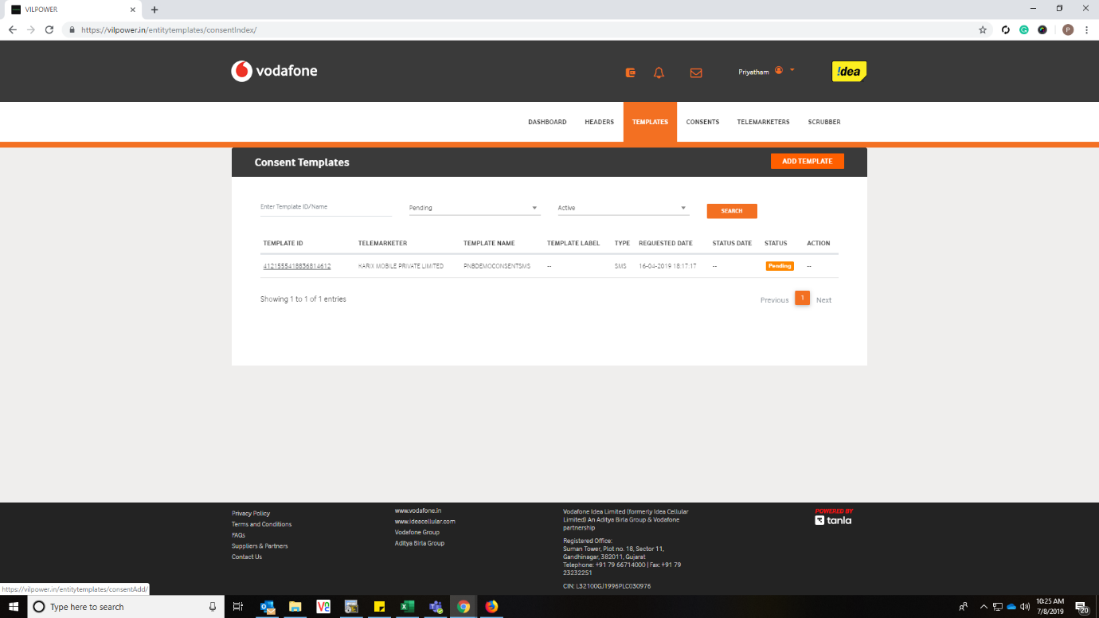
Click on ADD TEMPLATE Button to register a new Consent Template.

Slide 7
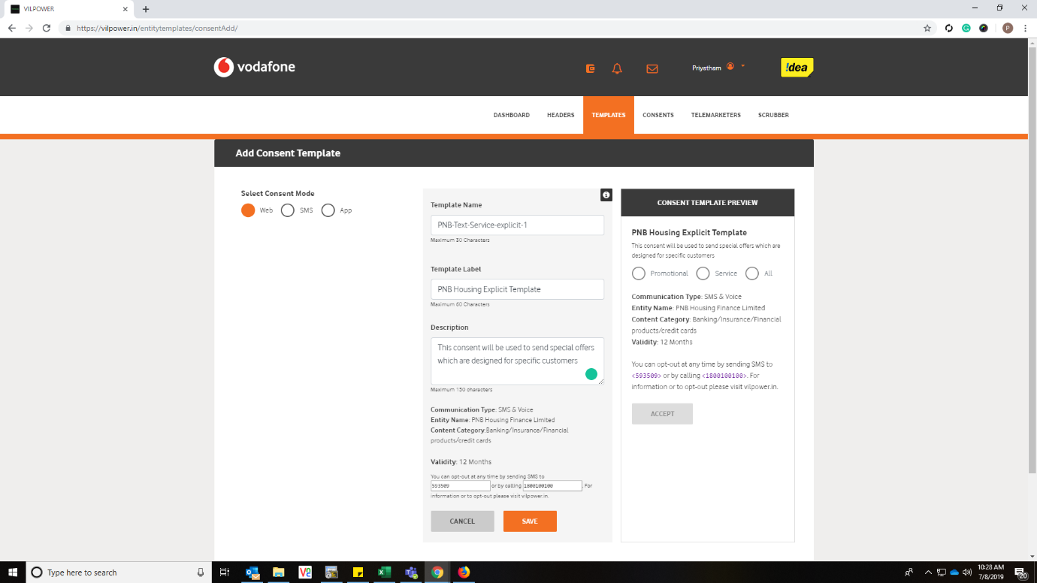
Enter Consent Template details.

Slide 8
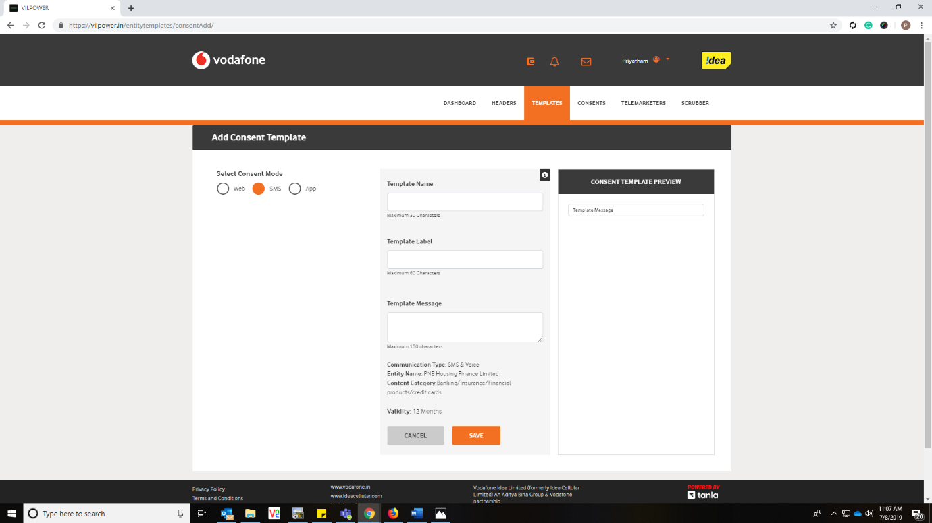
Select appropriate mode of communication (Web, SMS & App) for which you are registering the template and click on SAVE button.

Slide 9
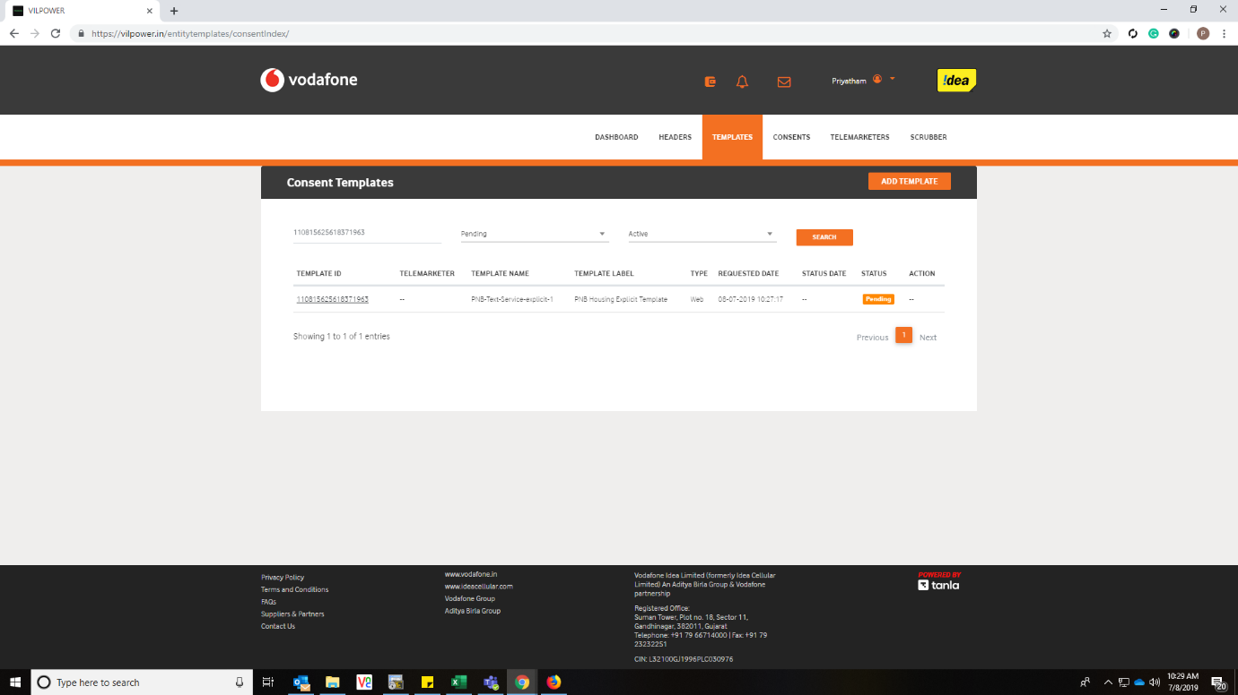
Post saving the templates, below screen shown with Pending for approval by Registrar.

Slide 10
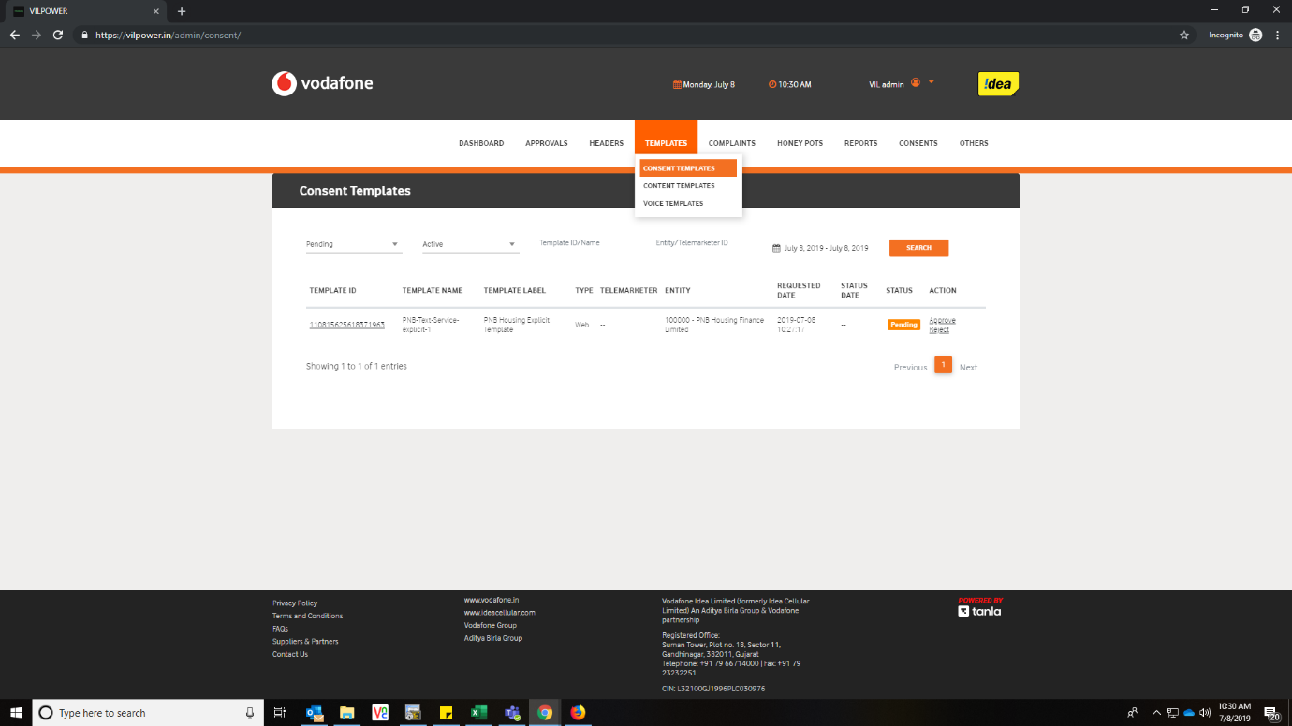
Login to the Registrar portal and click on Consent Templates under Templates Tab.

Slide 11
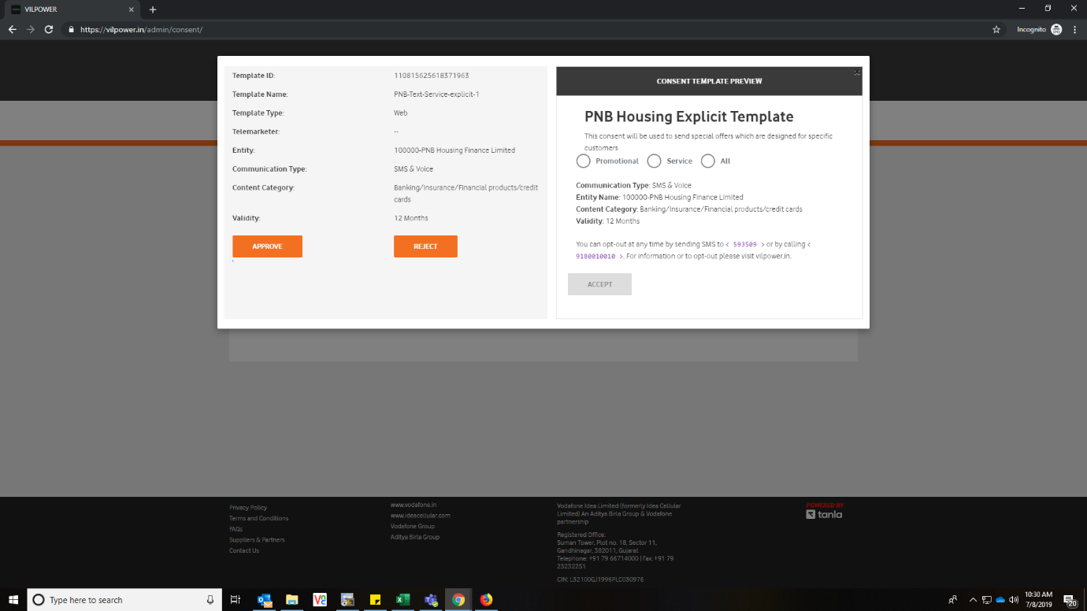
To View the Consent Template and click on the Template ID which will show you complete details of template in a popup window.

Slide 12
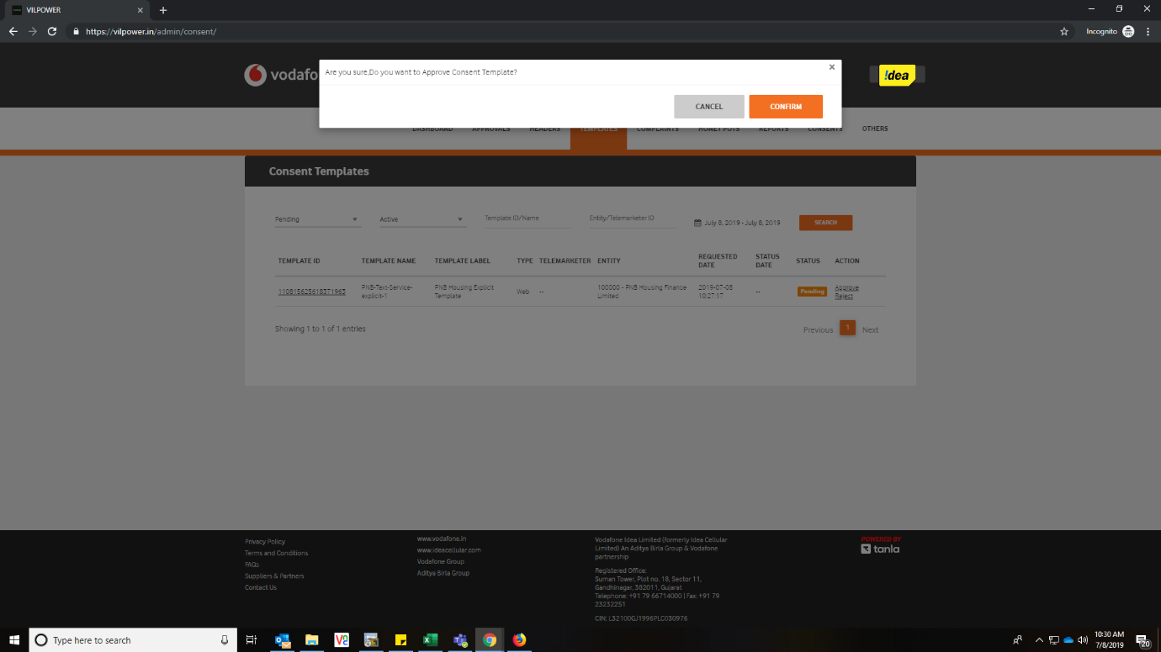
Post Review, once you Click on Approve button, it shows below re-confirmation screen.

Slide 13
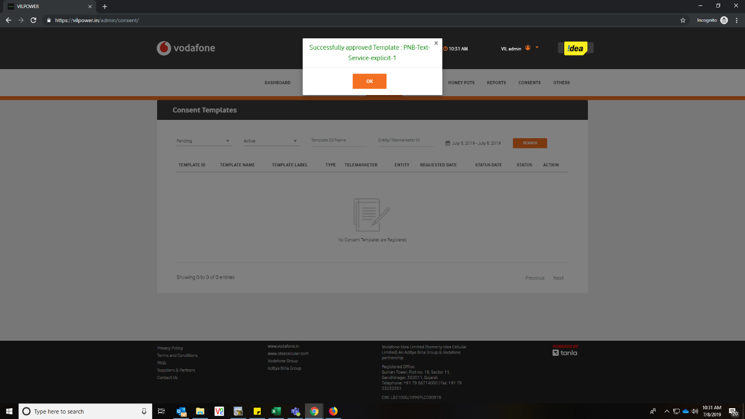
Once you click on Confirm button in above screen, below confirmation screen is shown and displays Template is approved.

Slide 14

Now go back to the PE login and check if the Template is whitelisted or not

Slide 15




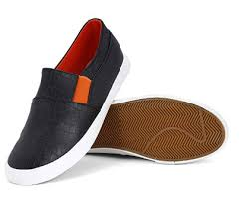
How to read different type of messages as per the new regulation
Flipkart sends a message to User about 50% off on shoes
User creates a new account on Flipkart. Selects a product and goes to payment gateway for purchase
Bank sends OTP
Bank sends debit message after successful payment
Flipkart sends a confirmation message
Flipkart sends a message after 4 hours stating that the product is out for delivery
User receives the product. Flipkart sends a confirmation message
Flipkart sends a message on ‘Bill Billion Day’ to User after 2 months
Transactional
Service Implicit
Service Implicit
Service Implicit
Promo
Promotional
Service Implicit
Flipkart can take a consent from User to send Service messages during the Signup process
User should have been in No-Block mode to receive Promotional message
In case the User opts out from receiving Service messages, this becomes a Promotional message

Slide 16


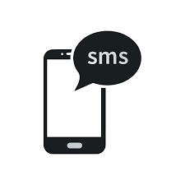
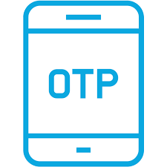

How to read different type of messages as per the new regulation
User receives a message from ICICI Lombard on Health Insurance with special 20% off for all its Term Insurance customers
User logs into his ICICI Lombard login and goes to payment gateway for payment
Credit Card company sends OTP
Credit Card company sends debit message after successful payment
ICICI Lombard sends a confirmation message for purchase of Health Insurance
ICICI Lombard sends a message with Insurance Policy No. and other details after 60 minutes
ICICI Lombard sends a message before 12 months reminding the User about the Health Insurance policy renewal
User doesn’t renew the policy. ICICI Lombard sends a message 2 months after the renewal date with a 15% discount coupon
ICICI Lombard sends a special offer with 30% discount after 3 months
Service Implicit
Service Implicit
Service Implicit
Service Explicit
Service Explicit
Transactional
Service Explicit
Service Implicit
Entity should have taken the consent from user to send Service messages
This would become promotional in case if the user opts out from Service messages

Slide 17


